Slide 1

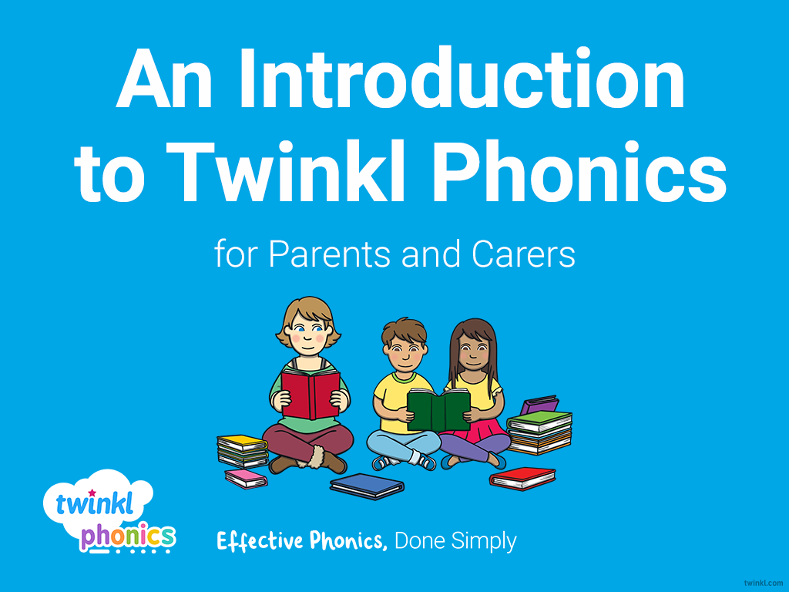

Slide 2
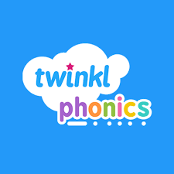
What is Phonics?
How do we teach Phonics at CMCS?
What is the Phonics Screening Check?
How do we teach Early Reading at CMCS?

Slide 3
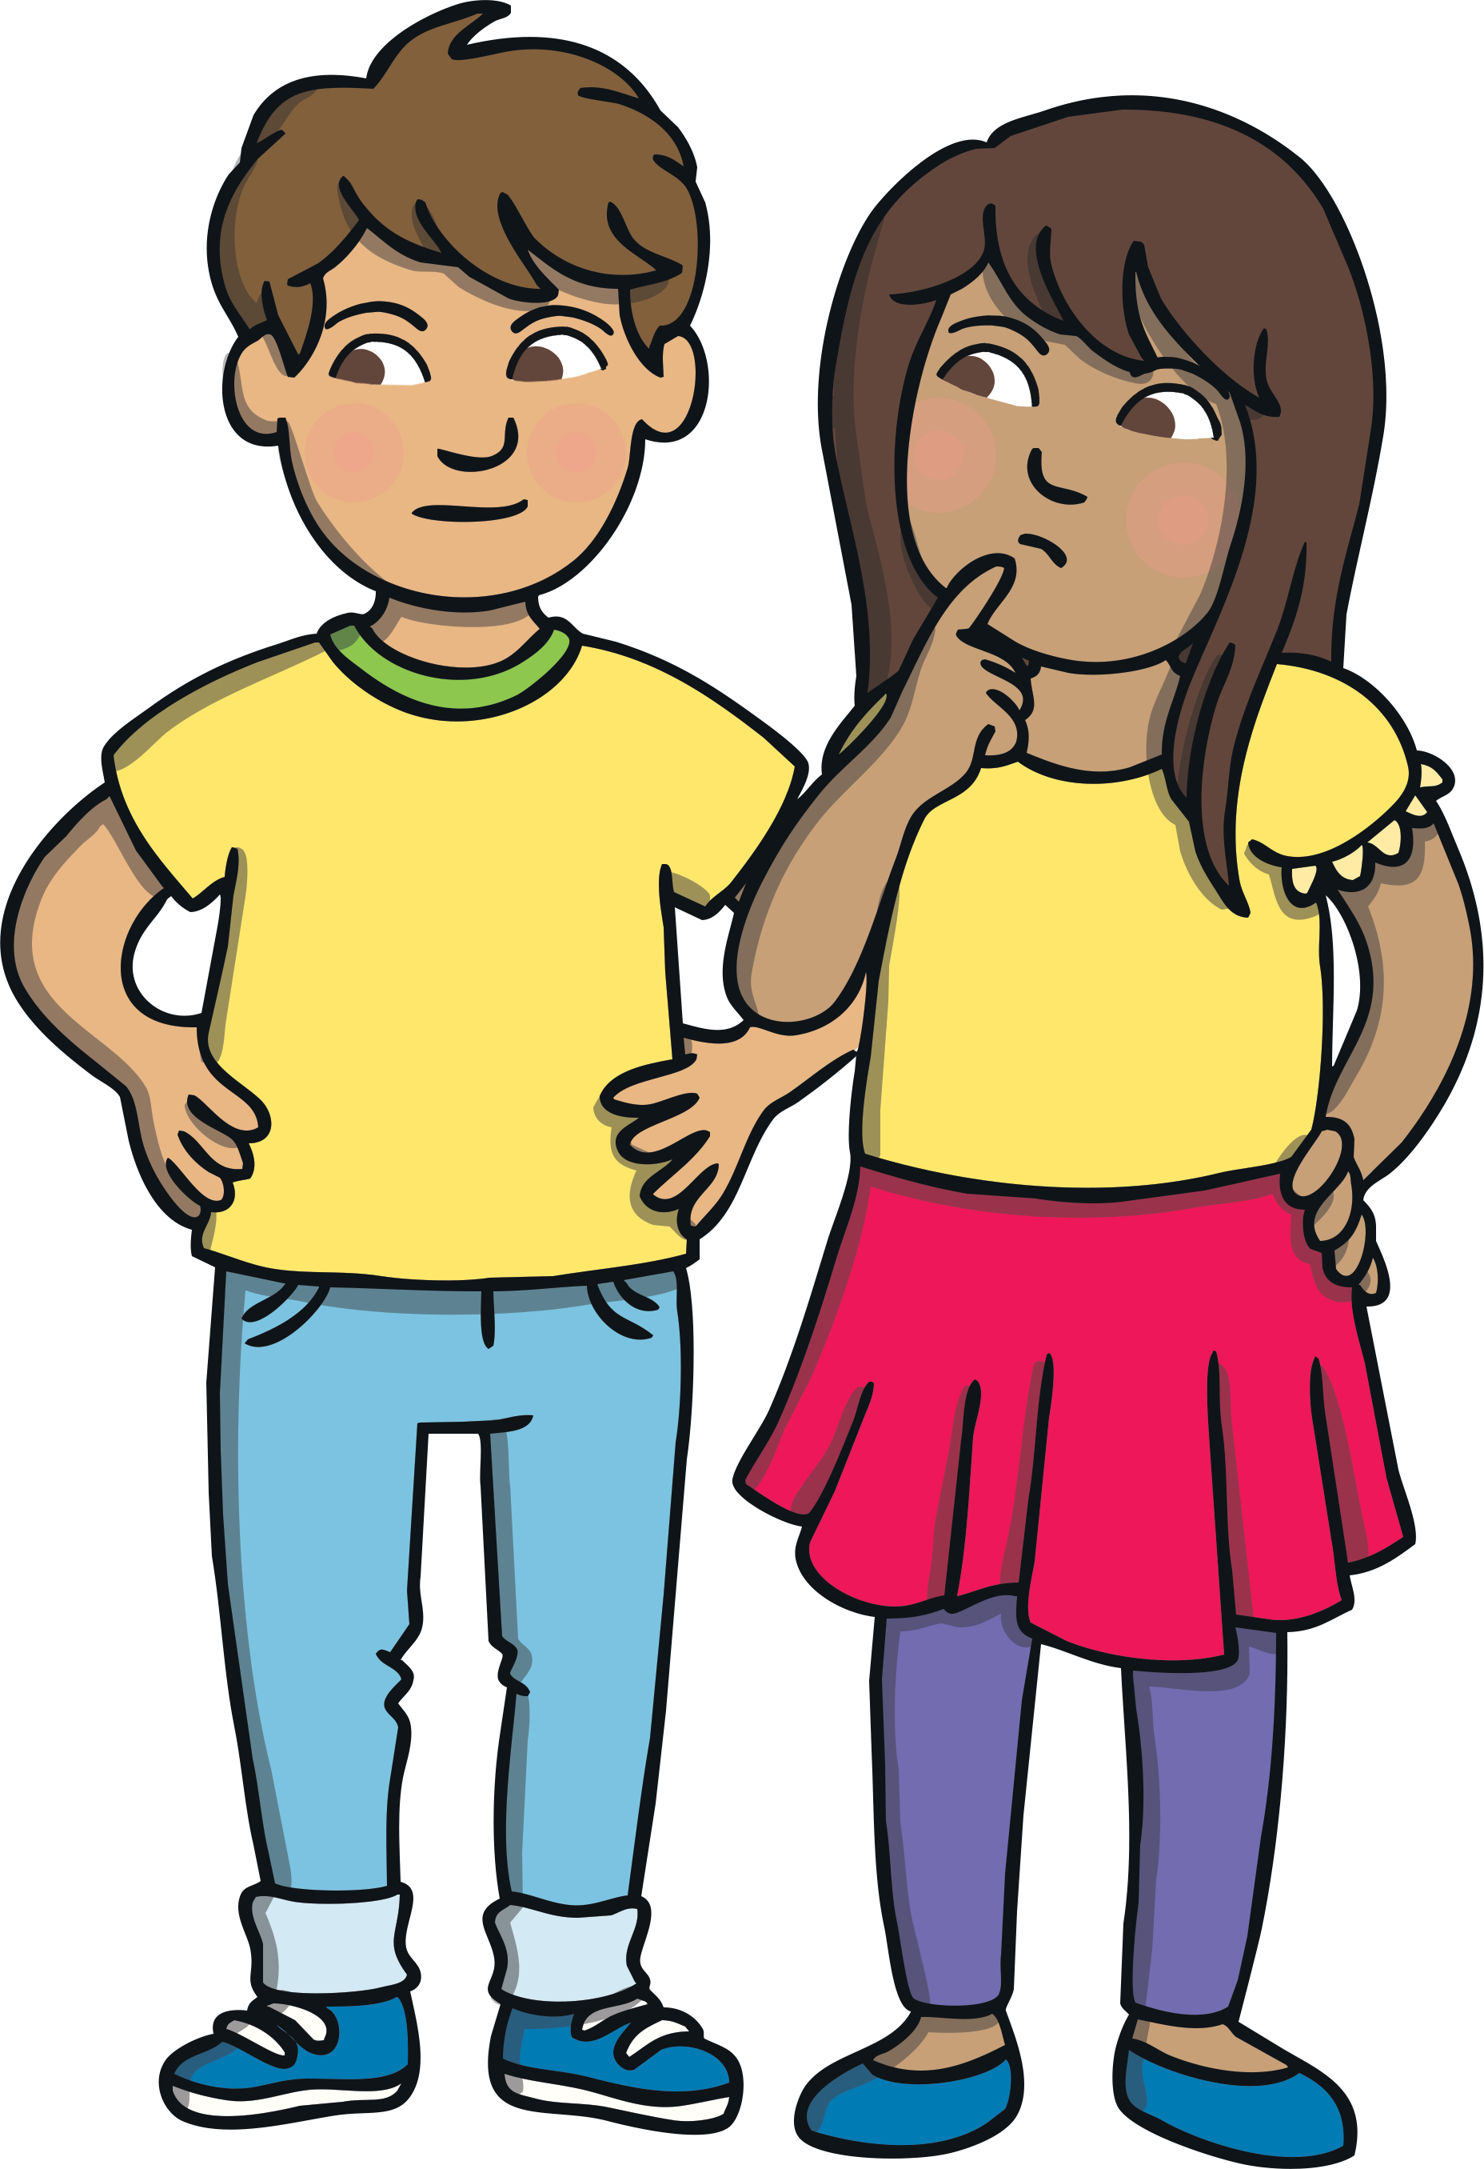
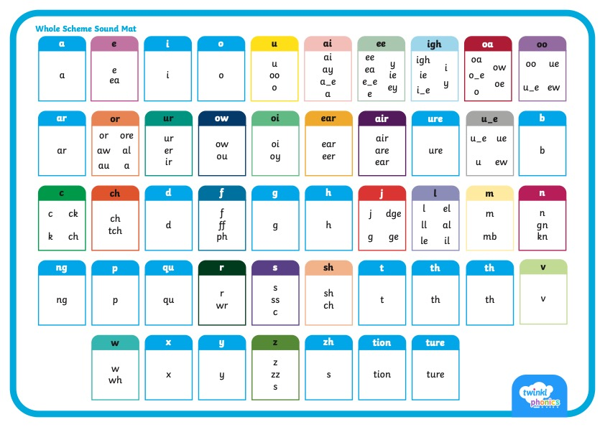
      Did You Know…?
There are 26 letters in the alphabet but there are 44 sounds and over 100 different ways of spelling them.
This is why English is one of the most complex languages to learn!

Slide 4
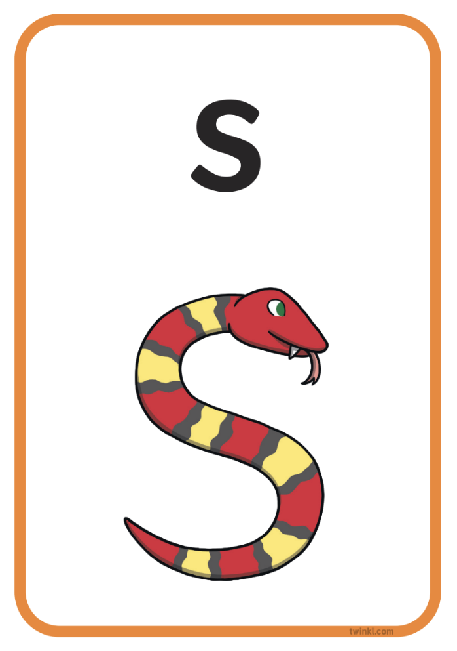
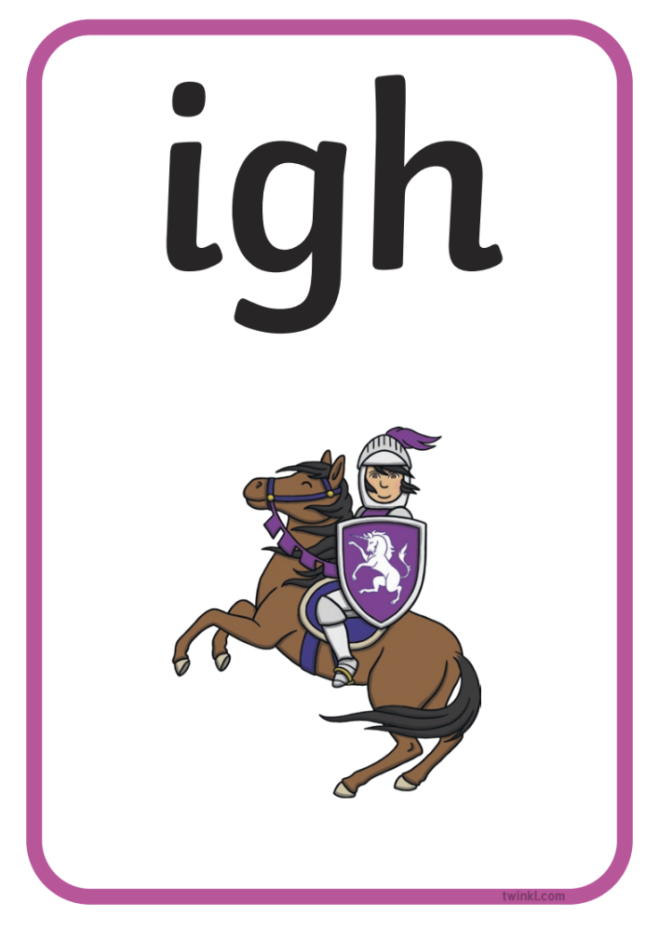
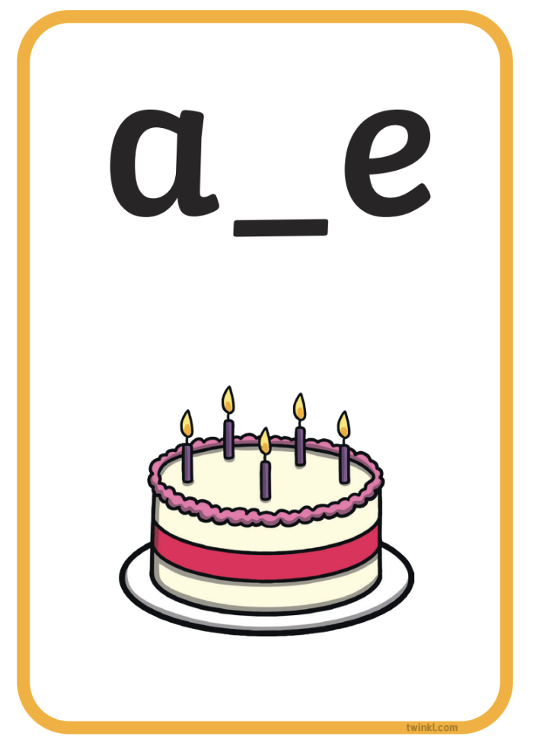


Phonics Terminology
Here is some of the terminology you might hear as your children begin to learn phonics.
Phoneme | the smallest unit of sound in words
Grapheme | the written representation of a sound
GPC (Grapheme-Phoneme Correspondence) | being able to match a phoneme with the correct grapheme and vice versa
Blending | joining individual speech sounds together to read a word
Segmenting | breaking down words into individual speech sounds to spell a word
Digraph | two letters making one sound e.g. ‘sh’
Trigraph | three letters making one sound e.g. ‘igh’
Split Digraph | two letters making one sound which are divided by a consonant e.g. the i_e sound in the word ‘side’
Tricky/Common Exception Words | words that are not fully decodable such as ‘the’ and ‘was’
Sound buttons | circles or spots that can be written underneath a sound to support reading
Sound bars | lines that can be written underneath digraphs or trigraphs to show that the letters make one sound
Mnemonic | a visual prompt to help children remember a sound

Slide 5
      What Is Synthetic Phonics?
Synthetic phonics is a method of teaching reading and writing, in which words are broken up into their smallest units of sound or ‘phonemes’.
Children learn to associate a written letter or group of letters, known as ‘graphemes’, with each phoneme.
Sounds are then joined or ‘blended’ together into words for reading or, conversely, whole words are broken down or ‘segmented’ into their sounds for writing.
It is the UK’s most preferred method of teaching phonics.
Sounds are taught in a prescribed order starting with s, a, t, p, i, n, as this allows for the most words to be made from the start, such as ‘sat,’ ‘tap’ and ‘pin’.

Slide 6
      What Are the Benefits of Synthetic Phonics?
Children progress through the stages as they are ready.
Planning ensures progression and coverage.
Children can attempt new words working from sounds alone.
Reading and writing become practices that are developed hand in hand.

Slide 7

      What Is Taught and When?
Twinkl Phonics Level | Number of Teaching Weeks | Recommended Year Group (UK schools) | Age of Children
Level 1 | 36 | Nursery/Preschool | 3-4 years
Level 2 | 7 | Reception | 4-5 years
Level 3 | 12 | Reception | 4-5 years
Level 4 | 5 | Reception | 4-5 years
Level 5 | 30 | Year 1 | 5-6 years
Level 6 | 30 | Year 2 | 6-7 years
Level 1 continues to be taught alongside the other levels.
This is just an overview. We understand that every child progresses at their own pace.

Slide 8
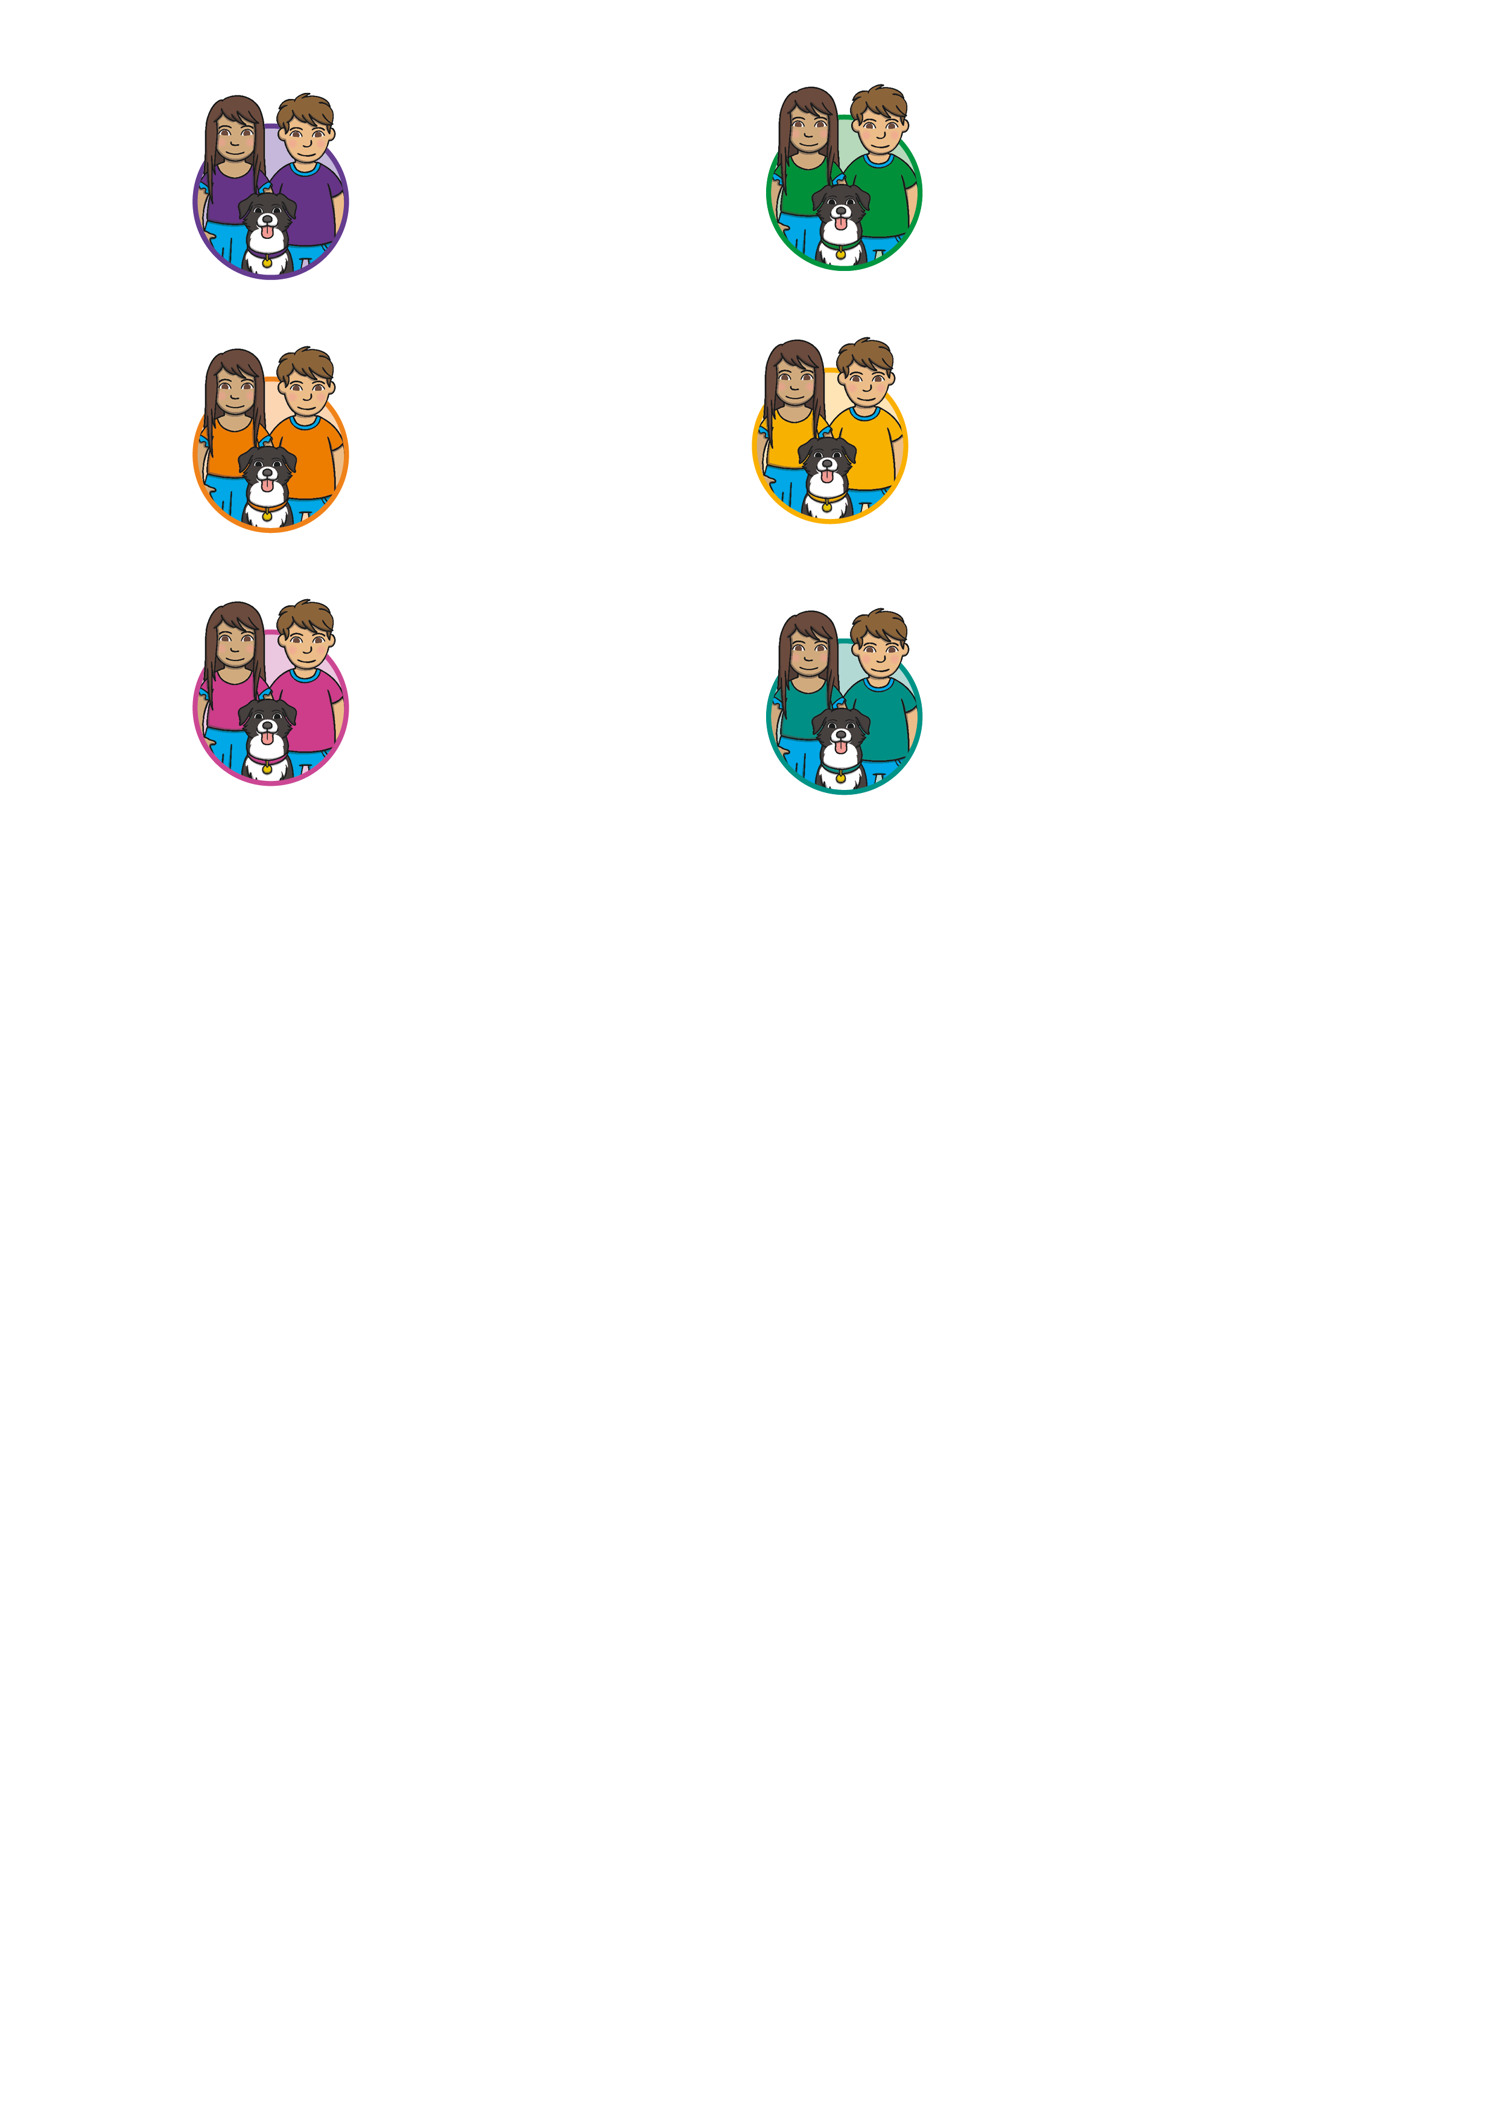

      Level 1
Level 1 is taught in Nursery/Preschool.
By the end of Level 1, children will have had the opportunities to:
listen attentively;
enlarge their vocabulary;
speak confidently to adults and other children;
discriminate different sounds including phonemes;
reproduce audibly the phonemes they hear in words;
orally segment words into phonemes.
These learning opportunities are presented through 7 Aspects.

Slide 9
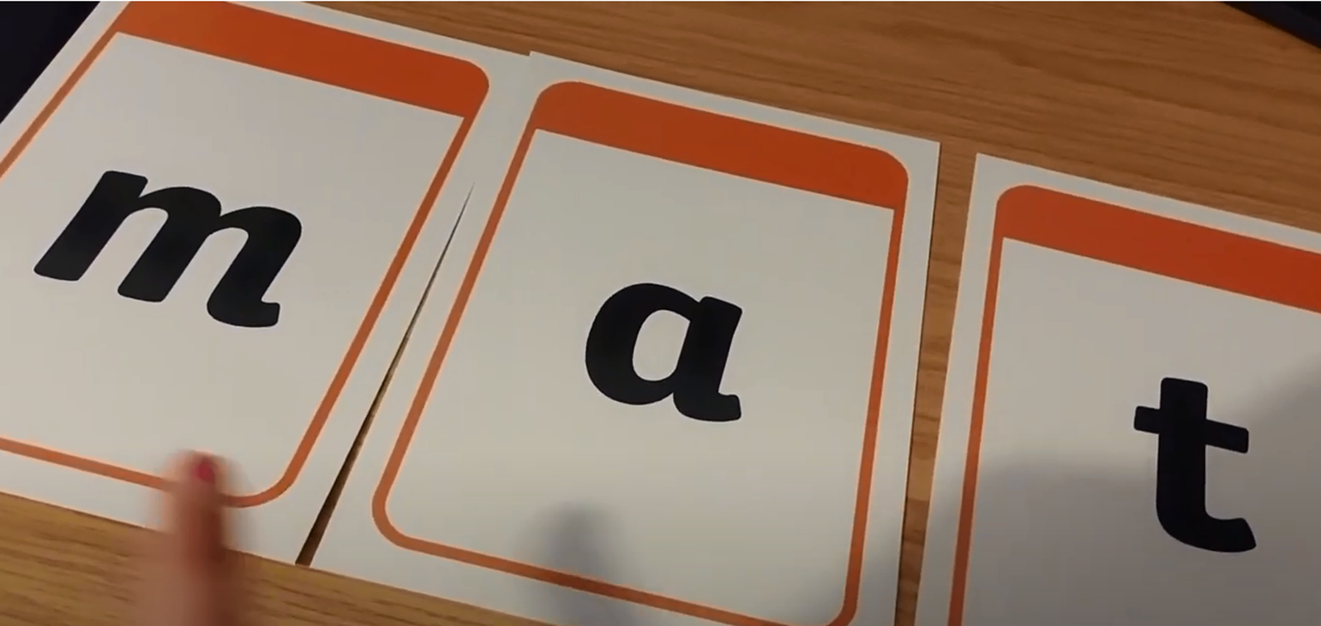
      Pure Sounds

Slide 10

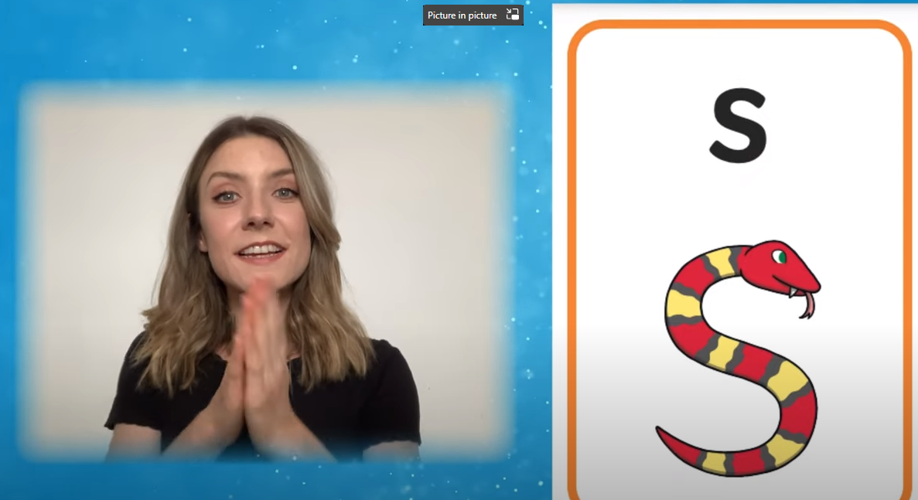
      Level 2 Actions and Mnemonics

Slide 11
      Level 2 Actions and Mnemonics
Every sound has a corresponding action and mnemonic which helps children to remember them. You can support your child by modelling the same sounds and actions at home.

Slide 12
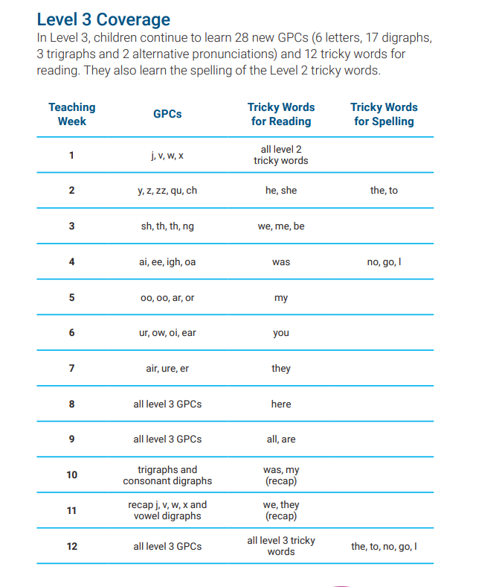
      Level 3
Level 3 is taught in Reception.
By the end of Level 3, children will have had the opportunities to:
say the phoneme when shown all or most Level 2 and Level 3 graphemes;
find all or most Level 2 and Level 3 graphemes, from a display, when given the phoneme;
blend and read CVC words (single-syllable words consisting of Level 2 and Level 3 graphemes) such as ‘chop’ and ‘night’;
segment and make phonetically plausible attempts at spelling CVC words (single-syllable words consisting of Level 2 and Level 3 graphemes) such as ‘paid’ and ‘seed’;
read the tricky words - he, she, we, me, be, was, my, you, her, they, all, are & spell the tricky words - the, to, I, no, go;
write each letter correctly when following a model.

Slide 13
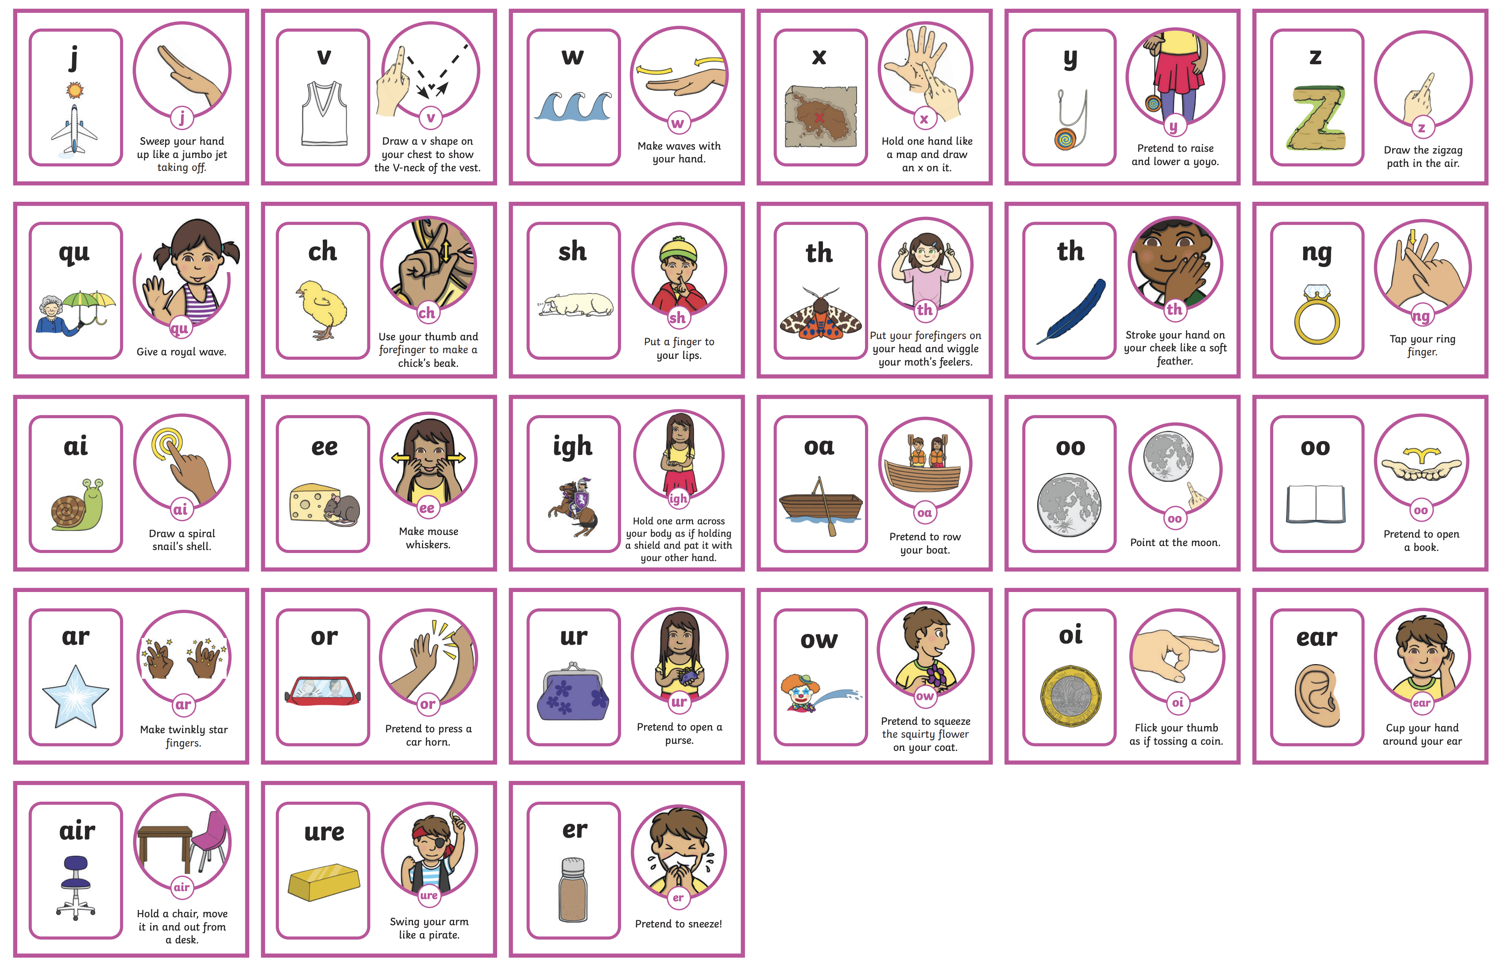
      Level 3 Actions and Mnemonics
It is really important that children learn to form the letters using the correct letter formation when writing. As they are introduced to a new sound, children are taught how to write it correctly. It would be great if you could also model this at home.
Click on the link to hear the sounds and actions

Slide 14
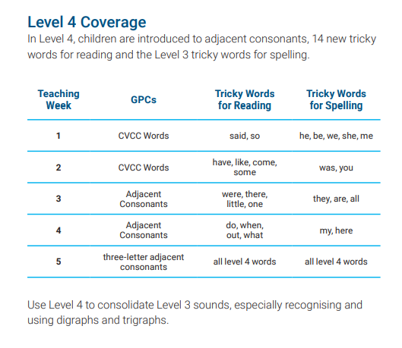

      Level 4
Level 4 is taught in Reception.
By the end of Level 4, children will have had the opportunities to:
give the phoneme when shown any Level 2 or Level 3 grapheme;
find any Level 2 or Level 3 grapheme when given the phoneme;
blend and read words containing adjacent consonants as well as segment and spell words containing adjacent consonants, such as ‘sand’, ‘bench’ and ‘flight’;
read the tricky words - some, one, said, come, do, so, were, when, have, there, out, like, little, what & spell the tricky words - he, she, we, me, be, was, my, you, here, they, all, are;
write each letter, usually using the correct formation;
orally segment words into phonemes.
No new sounds are taught in Level 4.

Slide 15

      Level 5
Level 5 is taught in Year 1.
By the end of Level 5, children will have had the opportunities to:
give the phoneme, when shown any grapheme that has been taught;
for any given phoneme, write the common graphemes;
apply phonics knowledge and skills as the primary approach to reading and spelling unfamiliar words that are not completely decodable;
read and spell phonically decodable two-syllable and three-syllable words such as ‘dolphin’ and ‘parachute’;
read automatically all taught tricky and common exception words;
accurately spell all the Level 2, 3 and 4 tricky words and most of the common exception words for reading;
form each letter correctly;
use alternative ways of pronouncing and representing the long vowel phonemes.

Slide 16
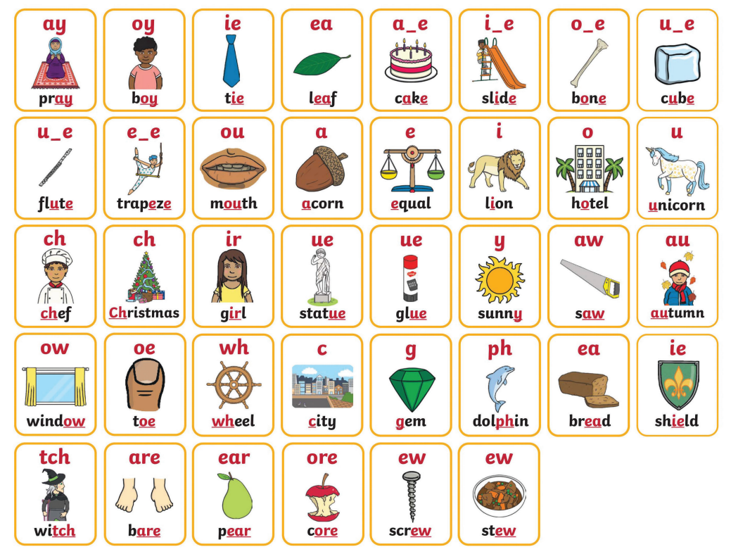
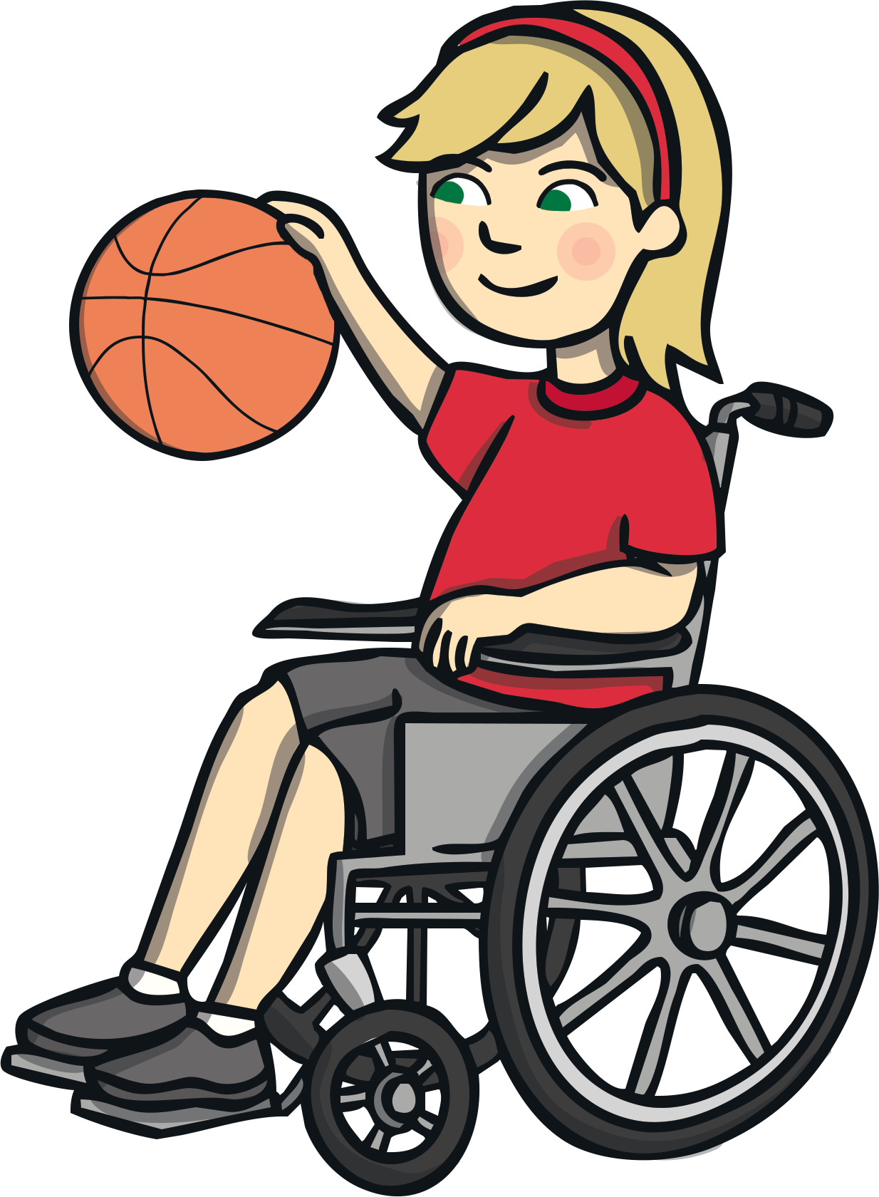
      Level 5 Mnemonics
The new sound is displayed within a word linked to the mnemonic for Level 5.

Slide 17
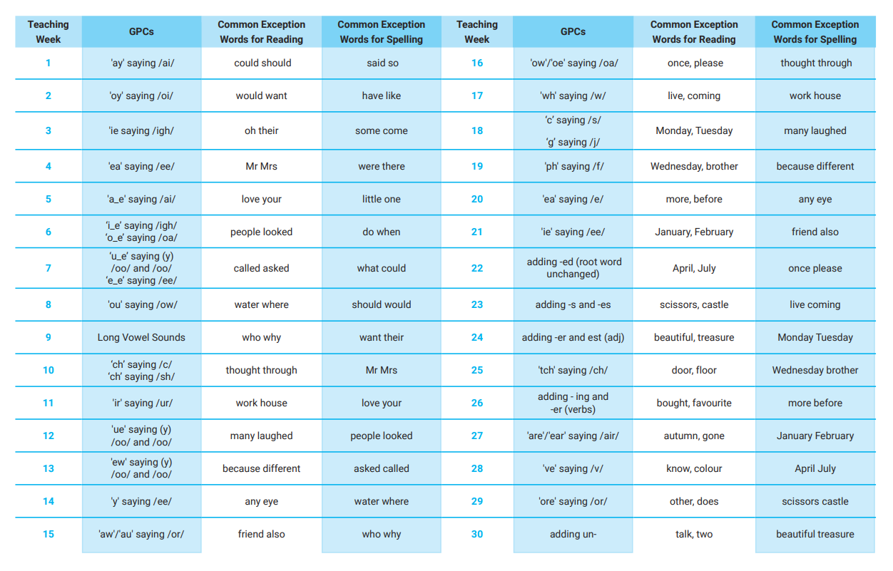

      Level 5 Overview

Slide 18

      Level 6
read accurately most words of two or more syllables;
Level 6 is taught in Year 2.
By the end of Level 6, children will have had the opportunities to:
read most words containing common suffixes;
read most common exception words;
read most words accurately, in age-appropriate books, without overt sounding and blending, fluent enough to allow them to focus on their understanding rather than on decoding individual words;
At this stage, children can read hundreds of words automatically. They are now reading for pleasure and reading to learn rather than learning to read.
sound out most unfamiliar words accurately, without undue hesitation;
segment spoken words into phonemes and represent these by graphemes, spelling many of these words correctly and making phonetically plausible attempts at others;
spell most common exception words correctly.

Slide 19
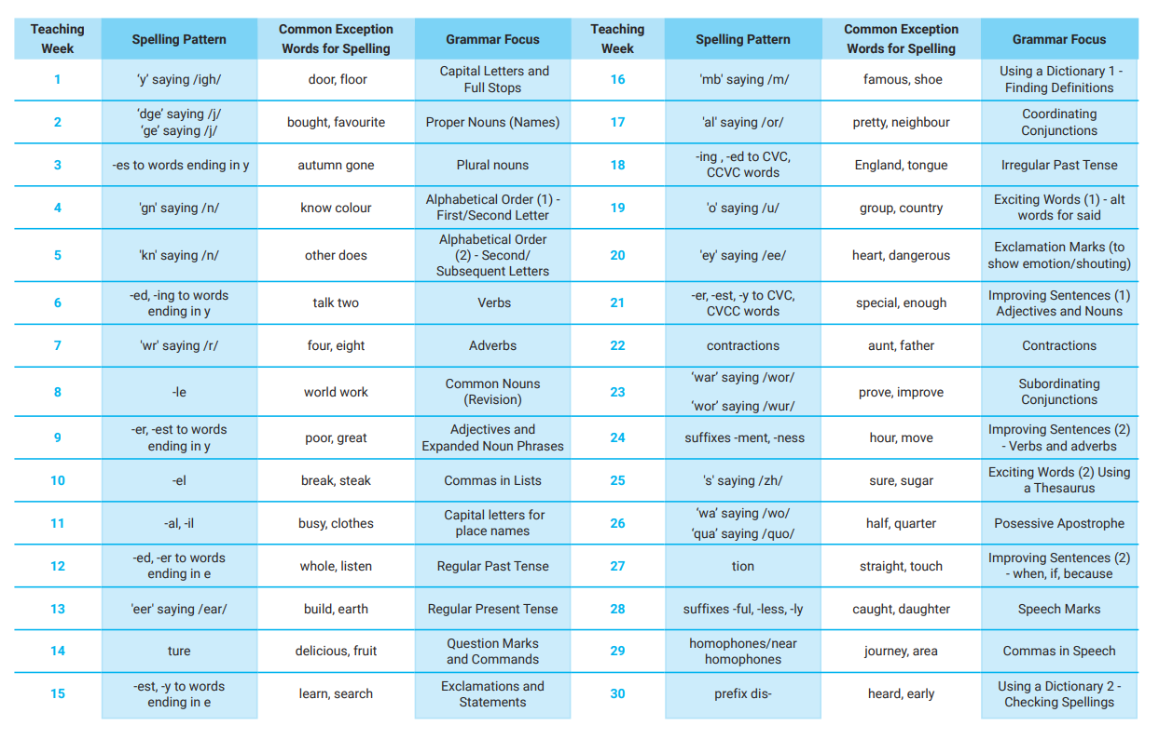

      Level 6 Overview

Slide 20
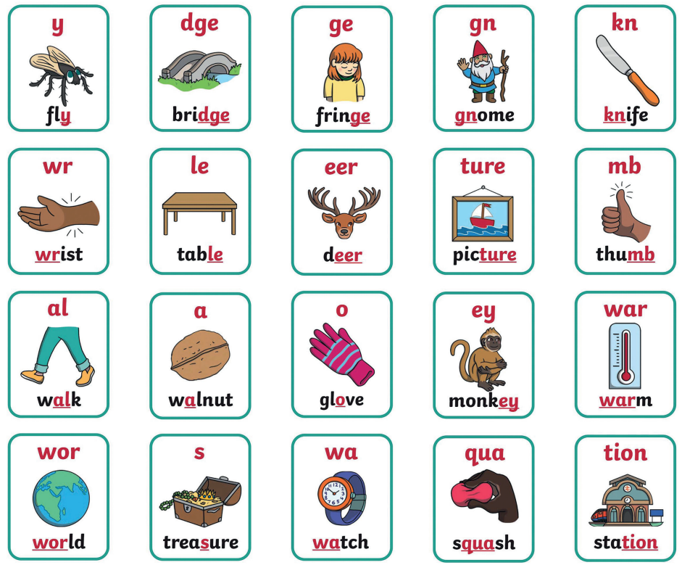

      Level 6 Mnemonics

Slide 21
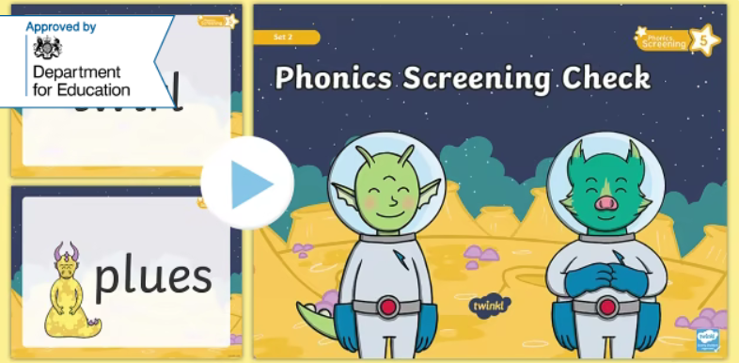
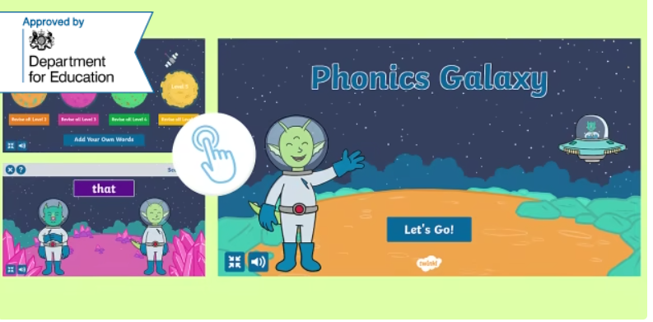
      Year 1 Phonics Screening Check
In June, all year 1 children are expected to complete the Year 1 Phonics Screening Check.
The aim is to check that a child is making progress in phonics. They are expected to read a mixture of real words and ‘nonsense’ words. (Nonsense words can also be referred to as ‘pseudo’ or ‘alien’ words)
For more information why not take a look at the
Twinkl Phonics Year 1 Screening Check Guide for Parents
If a child has not reached the expected standard, schools must give additional support to help the child to make progress in year 2.
Children who have not passed the check in year 1 will have the opportunity to retake it in year 2.

Slide 22


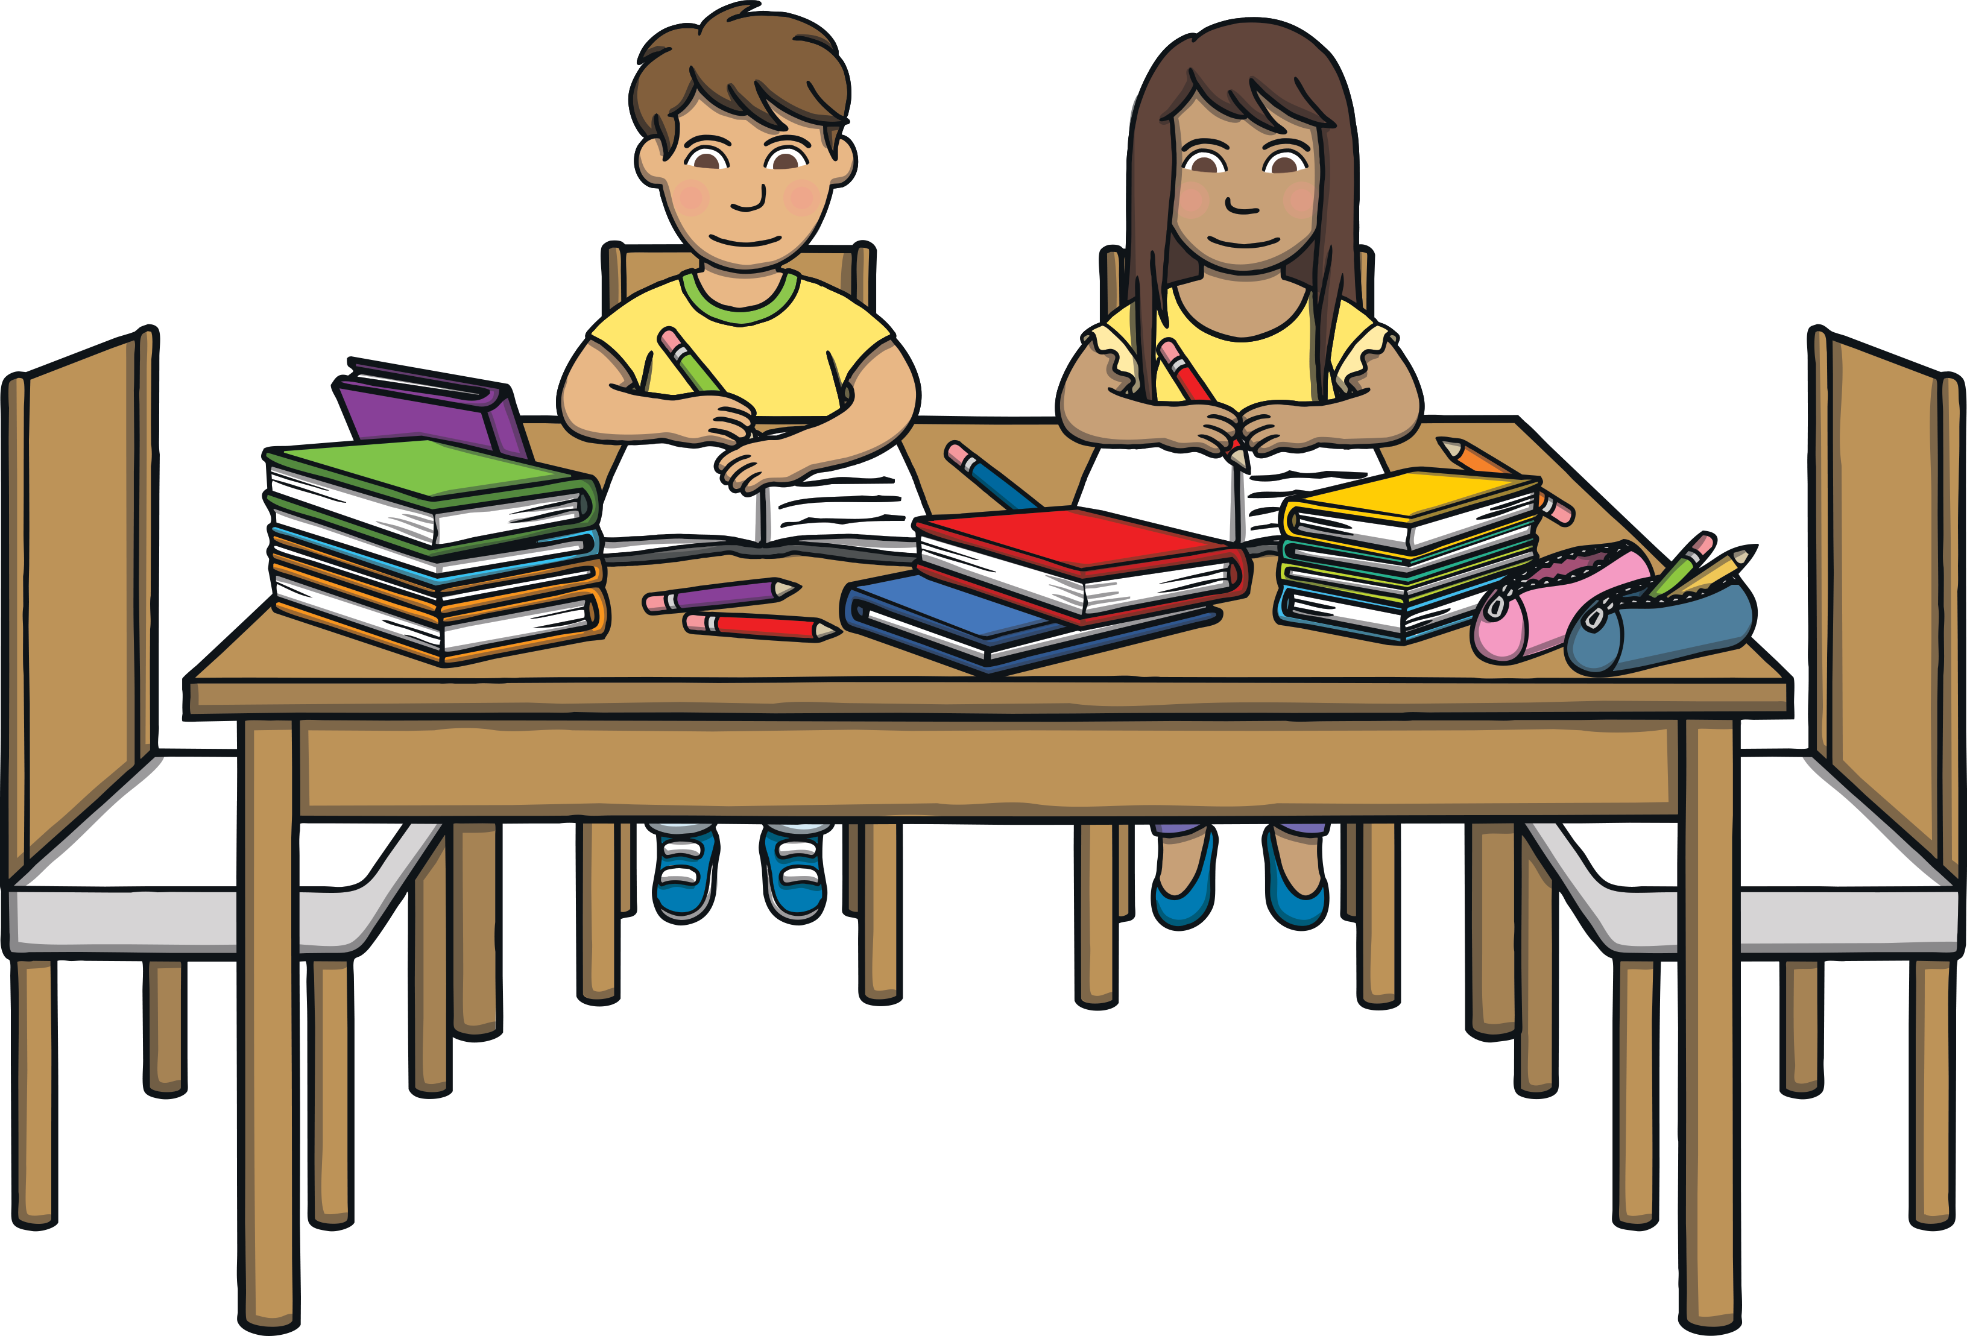
      How You Can Help Your Child at Home
Work on listening skills, taking turns and encouraging your child to look at you when you are speaking.
Practise segmenting and blending words.
Look for familiar sounds and words in the world around you. Such as, when in the supermarket, can your child find words on your shopping list or recognise letters on food packaging?
When outside, can they recognise letters on street names or on car number plates?
When in the house, can they recognise letters or words in magazines or letters you receive?

Slide 23
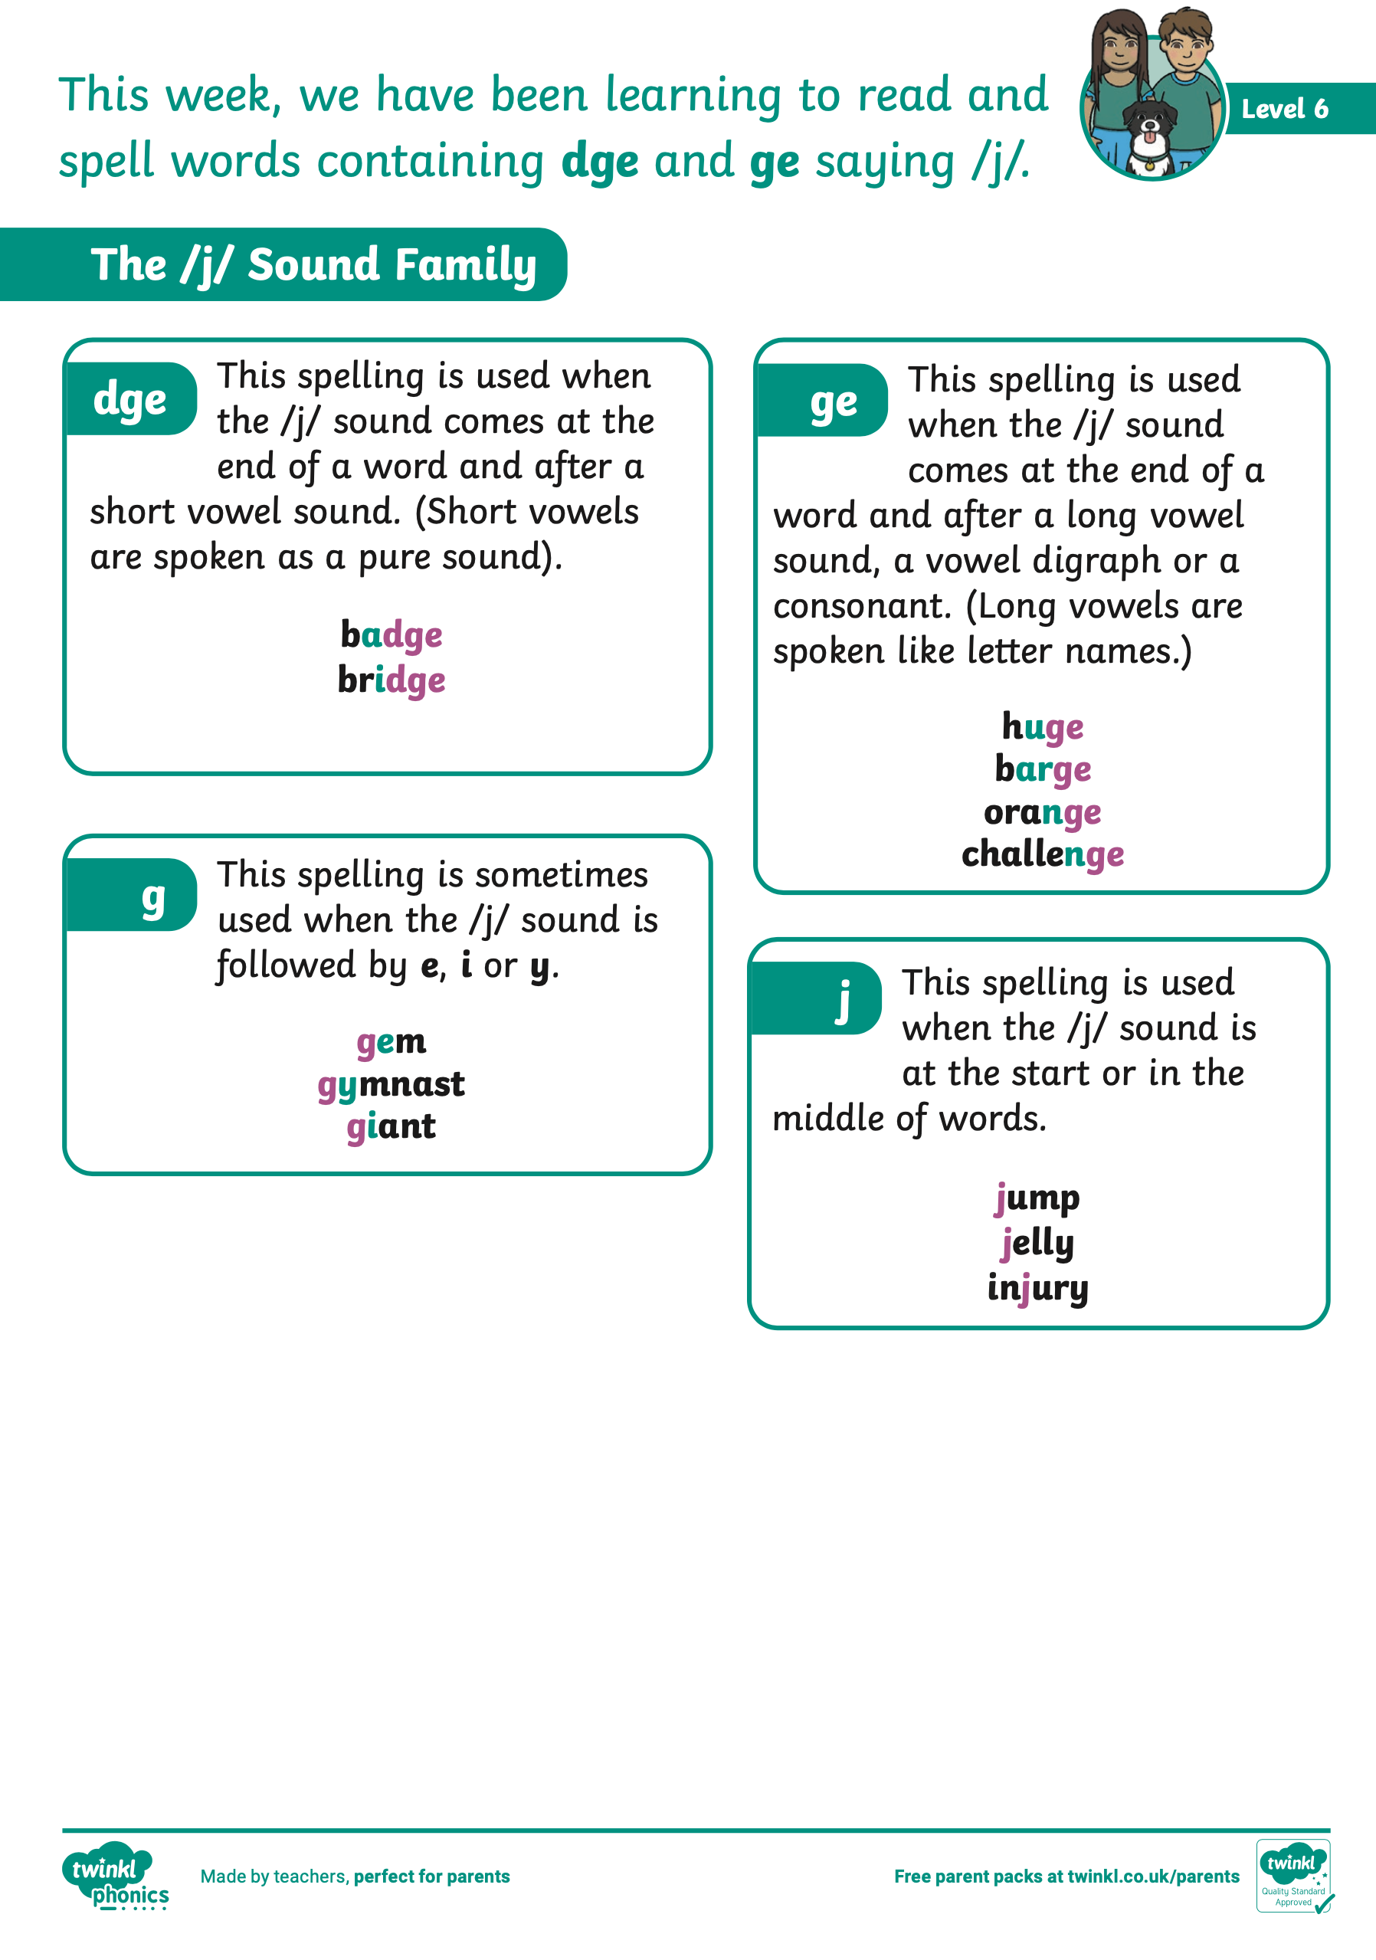
      How You Can Help Your Child at Home
Practise the new sounds and graphemes your child brings home using the Parent Information Sheets. Remember to use ‘pure’ sounds when pronouncing the sounds and model the correct letter formation as is taught in school.
Support your child to complete any homework they bring home.
Read to and with your child every day.
Finally, remember to ask your child’s class teacher if you are unsure about any aspect of your child’s phonics learning. A consistent approach is important.

Slide 24


Slide 25
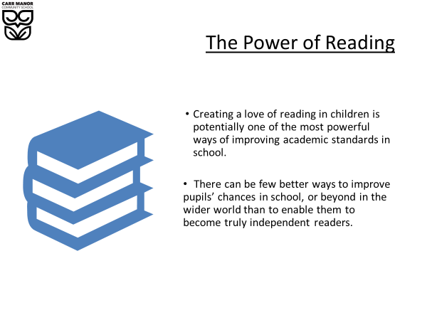

Slide 26

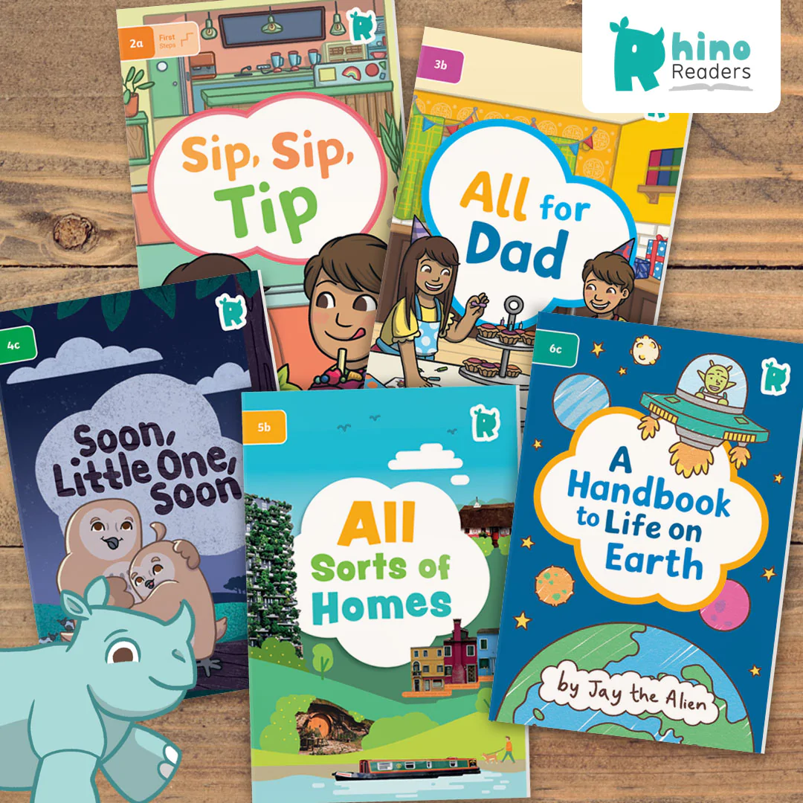
‘Warm up’ before launching in
For the youngest readers, it’s important that they have the vocabulary to talk about what they can see on the cover - your child needs to name the things they can see and use simple sentences to describe them. This pre-reading talk is vital for a beginner, so don’t rush.
Notes:
Children usually need a little preparation before tackling a text. In fact, the reading experience starts well before the child sees any words on the page. For the youngest readers, it’s important that they have the vocabulary to talk about what they can see on the cover - your child needs to name the things they can see and use simple sentences to describe them. Once they get more confident, children can tell you what they think is going to happen in a story, or what they might learn about in a non-fiction text. This pre-reading talk is vital for a beginner, so don’t rush. If they get muddled, model the sentence aloud for your child to say back to you.

Slide 27
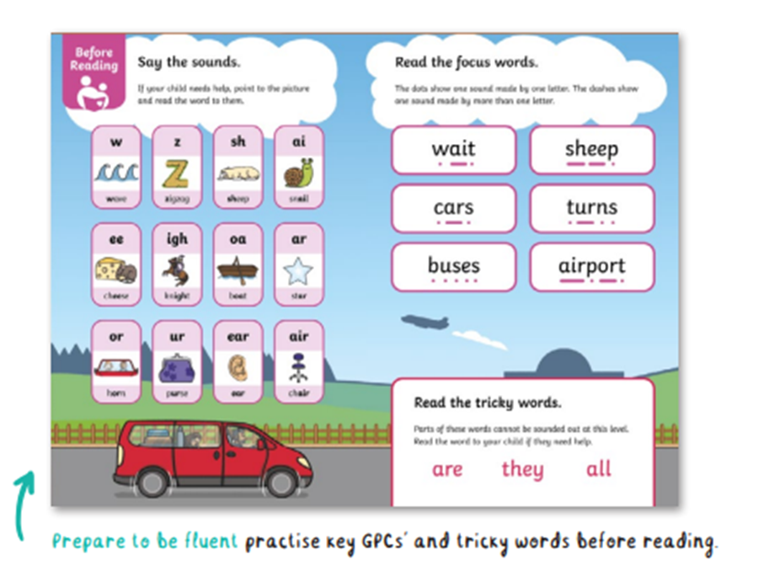
Your child will already have been taught all the sounds and tricky words you can see on the page.
Practise quick recall - point to the sound cards and ask your child to say them, then repeat with the tricky words.
Try to keep this fast paced - it’s an introduction to reading rather than a lesson in itself.
Decodable books match the children’s phonic knowledge
Notes:
With the emphasis on decodable books being matched to children’s phonic knowledge, you can assume that your child will already have been taught all the sounds and tricky words you can see on the page. However, they’re quite likely to need a reminder, so don’t panic if you need to tell them again!
You can use this page to practise quick recall - point to the sound cards and ask your child to say them, then repeat with the tricky words. Try to keep this pacy - it’s an introduction to reading rather than a lesson in itself. If you find your child is really struggling to remember the sound cards, it could be a pointer that they need a little more work on this part of their phonics - something to flag up with their teacher.

Slide 28

Reread the book
Instil a love of reading
Become the expert
Children become more confident using fluency and expression
Children become more confident reading
Children gain a deeper level understanding of the text.
Notes:
Expect to read the book a few times
Once you know your learner can talk about the book subject and are able to recognise the letter sounds and tricky words, it’s time to get reading. As adults, we tend to see a book like a meal: we read it, digest it, and then we look for something new. But children love the process of getting familiar with a book and will often ask for a favourite story over and over again - the reason being, we’re asking them to practise so many skills, and they need repeated opportunities to master them all.
The first time a child reads a book, it’s really all about decoding the words and building them into sentences. This will quite literally be one word at a time at the early levels. It’s perfectly normal to have to read the word or sentence a few times before it all comes out fluently in the right order. With the Rhino Readers phonics books, the detailed supporting illustrations will be your friend, helping your child make sense of the narrative - so make sure you take a little time to look at the pictures before launching into the words.
On the first reading, you’ll be the ‘expert’ - but when you’re back with the book the second (third, or fourth!) time, you’ll transfer that role to your child. They’ll love taking charge of the discussion and explaining what’s happening in the book - and, because the reading process is smoother and easier with practice, it won’t feel like so much hard work to them.
These subsequent reads are the perfect time to dig deeper into comprehension, especially anything that requires children to think about the whole text rather than just the words on the page. It’s also a fab chance to help your child read with fluency and emphasis - what’s sometimes called a ‘storyteller voice’.

Slide 29
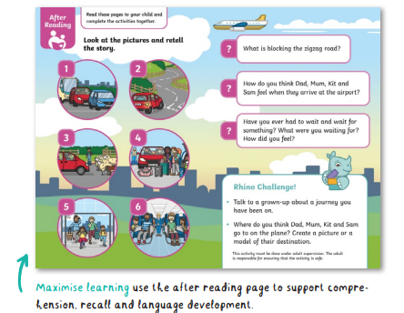
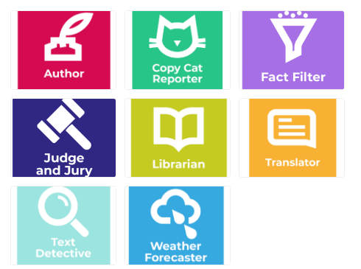
Understanding the text
Rhino Readers decodable books have an after-reading page. The questions provided are a great way to check key reading competencies: comprehension, vocabulary, sequencing and inference.

Slide 30
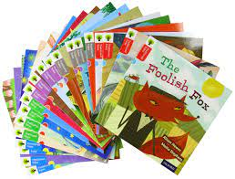
Years 1 and 2 Additional Books
In Years 1 and 2 children will have a mix of Rhino Readers and other books. This will let them become familiar with a wider range of texts and book types.
They will usually cover the six books in the Rhino Reader levels and then have 4 weeks covering other books before moving onto the next Rhino Readers level.

Slide 31
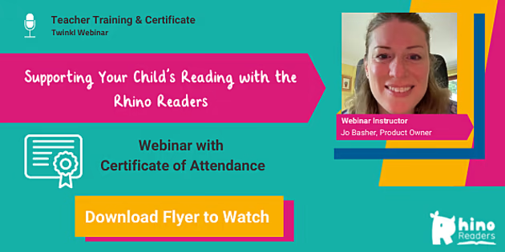
https://webinarkit.com/webinar/watch/6283645874e056d561a222cd?e=1663854476183

Slide 32
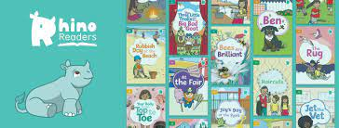
Top tips
Make sure your child is the one holding the book and doing the page turning.
Encourage them to flick backwards and forwards through the book to take ownership - they’ve done the hard work, and now the book is theirs to command.
Reading is best done in short burst regularly – 5-10 mins daily is best.
If your child is tired they may be reluctant to read so try to read before they’re too tired to concentrate.
Notes:
make sure your child is the one holding the book and doing the page turning. Encourage them to flick backwards and forwards through the book to take ownership - they’ve done the hard work, and now the book is theirs to command. We’ve kept everything here appropriate to the level of the book and, of course, closely followed the EYFS Framework and National Curriculum programmes of study when setting the after-reading activities.
Reading can - and should - lead beyond the book itself, and our Rhino Challenges are designed to be the next step. There’s a selection of ideas for each decodable book covering all bases, from arts and crafts, to drama and research. They’re designed to be fun while ensuring children cement their learning, have the chance to improve their language skills and make links to other things they’re knowledgeable about.

Slide 33
      Any Questions?

